Slide 1

Pitch Deck
STRATEGY-DRIVEN MARKETING THAT GROWS BRANDS
Taylor Alonso
STUDIO SHODWE

Slide 2

Table of Contents
3
4
5
Problem
Solution
Why Now?
6
7
8
Services Overview
Business Model
Competitive Advantage
9
10
11
Team
Roadmap
Contect Info
STUDIO SHODWE

Slide 3
Problem
Many small and growing businesses struggle to reach the right audience
1
Marketing is often inconsistent, outdated, or lacks strategy
2
Internal teams are stretched thin or lack digital expertise
3
STUDIO SHODWE
3

Slide 4



Solution
A flexible, end-to-end marketing partner
We combine strategy, creative, and analytics to drive real growth
Fully managed services or support for in-house teams
STUDIO SHODWE
4

Slide 5

Why Now?
  Rising cost of digital ads and competition
  Algorithm and platform changes require constant adaptation
  Buyers expect authentic, consistent content across all channels
STUDIO SHODWE
5

Slide 6
Services Overview
Marketing Strategy & Planning
Social Media & Content Creation
Campaigns & Paid Ads
Email, SEO, Blog & Copywriting
Analytics & Optimization
More
STUDIO SHODWE
6

Slide 7
Business Model
We offer flexible, scalable services for businesses of all sizes.
Monthly Retainer
Packages
One-Off Campaigns & Consulting
Workshops & Training for In-House Teams
  Tiered pricing (Starter / Growth / Premium)
  Includes a set number of services: strategy sessions, content creation, campaign management, etc.
  Ideal for businesses needing consistent support and measurable results over time
  Predictable revenue and long-term client relationships
  Project-based pricing for seasonal or special campaigns
  Includes short-term social media pushes, product launches, rebranding, or digital audits
  Ideal for clients testing the waters or addressing a specific need
  Interactive, skill-based training: SEO, social media strategy, content planning, reporting
  Delivered via webinars, video modules, or on-site sessions
  Great for businesses building internal marketing capability
  Revenue stream that also builds brand authority
STUDIO SHODWE
7

Slide 8
Competitive Advantage
Our approach blends strategic insight, creative execution, and data-driven optimization — tailored specifically for growing businesses.
Feature | Studio Shodwe | Big Agencies
Strategic Partnership | V | X
Affordable Flex Packages | V | X
Creative + Analytics Mix | V | V
Direct Client Access | V | V
STUDIO SHODWE
8

Slide 9
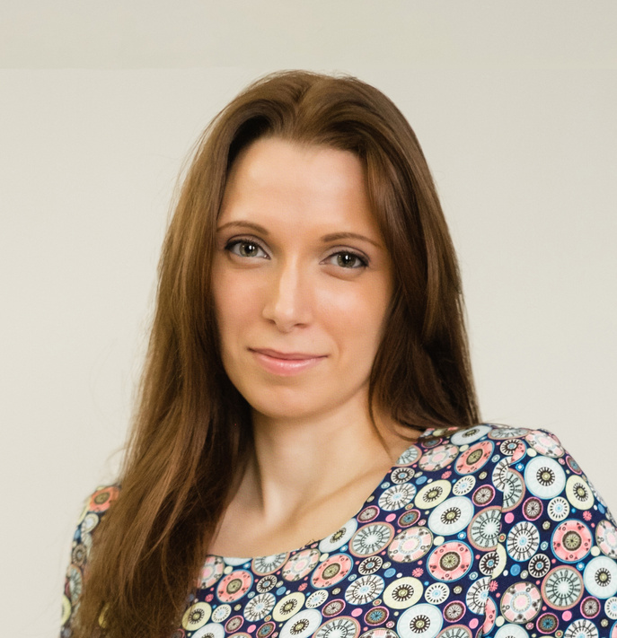
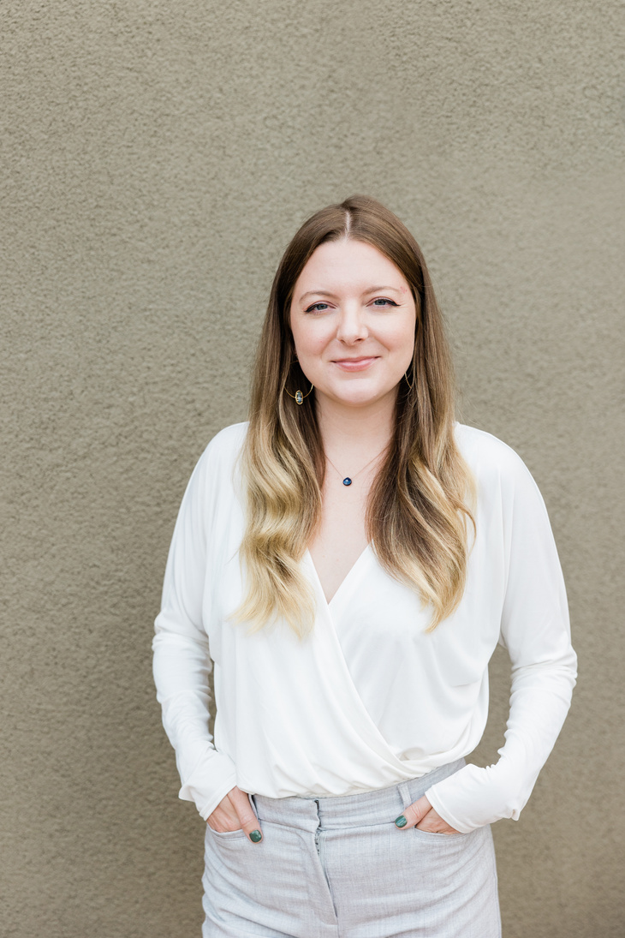
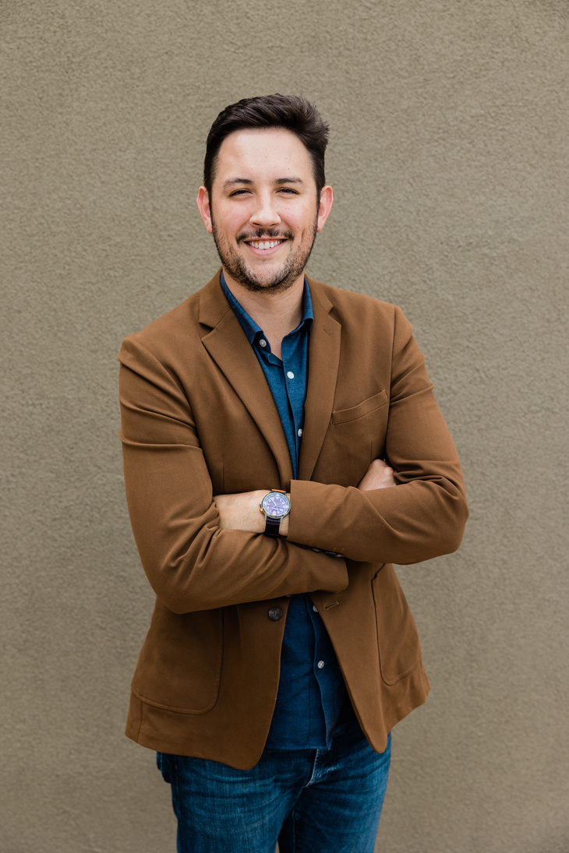
Team
Taylor Alonso
Shawn Garcia
Neil Tran
Founder / Marketing Strategist
Paid Ads & Funnel Expert
Analytics & Optimization
STUDIO SHODWE
9

Slide 10
Roadmap
Phase 1
Phase 3
Build portfolio & case studies
Develop marketing playbook tool
Phase 2
Phase 4
Launch marketing workshops
Scale via agency partners
STUDIO SHODWE
10

Slide 11
Contact Info
Let’s grow your brand together.
PHONE NUMBER
+123-456-7890
WEBSITE
REALLYGREATSITE.COM
EMAIL
HELLO@REALLYGREATSITE.COM
SOCIAL MEDIA
@REALLYGREATSITE
STUDIO SHODWE
11

Slide 12
The End
THANK YOU FOR LISTENING
Taylor Alonso
STUDIO SHODWE

